Slide 1
(K, T) - Route Privacy
Kan Qi
KQI@USC.EDU
Privacy in the World of Big Data (CSCI 599)
04/07/2017

Slide 2
Why do we care about our routes?
Routes provide information about our daily lives
Most people have a fixed set of routes for their daily lives
High chance of recurrence
Hacks: Addresses, Professions, Frequent Venues, or On-site Spy.
Our locations are sensed by the apps installed on our phones every second.
Routes can be easily inferenced at this frequency.

Slide 3
What we can do about it?
Don’t allow sampling our locations
Location information provides good utility – weather, navigation, and local recommendations.
Limit sampling frequency as policy
What frequency is appropriate?
How to get the data to understand an appropriate frequency?

Slide 4
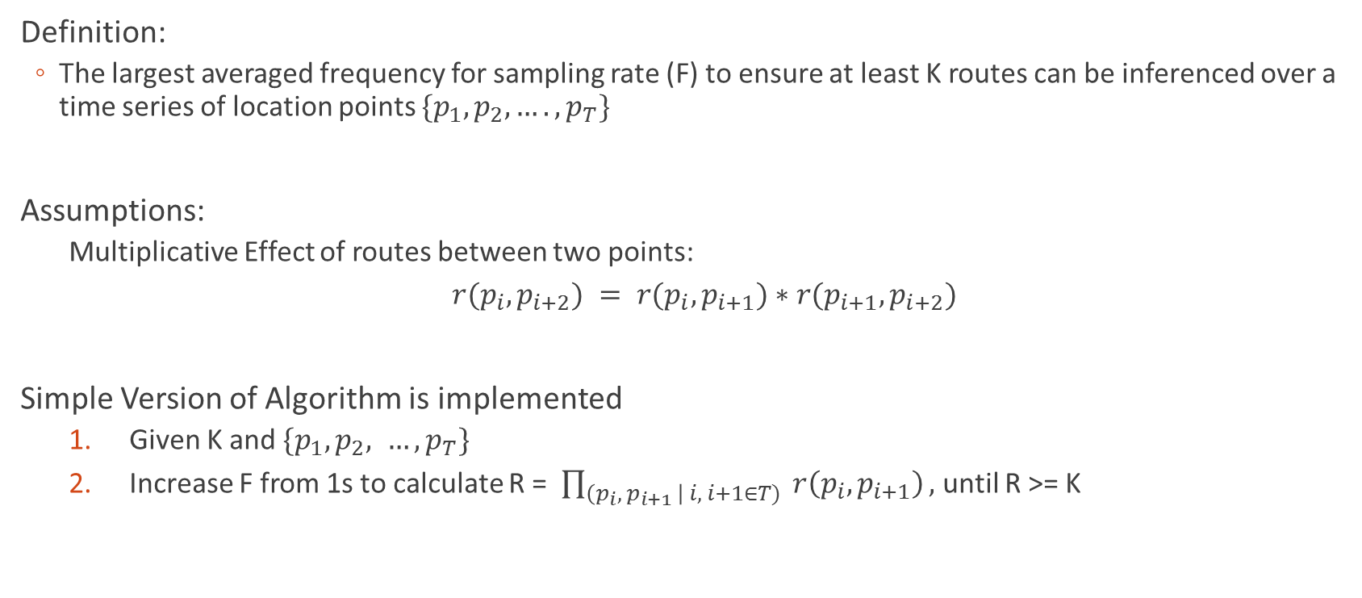
(K, T)-route privacy and algorithm
Definition:
The largest averaged frequency for sampling rate (F) to ensure at least K routes can be inferenced over a time series of location points $\{p_{1}, p_{2}, …., p_{T}\}$
Assumptions:
Multiplicative Effect of routes between two points:
$r(p_{i}, p_{i+2}) = r(p_{i},p_{i+1})∗r(p_{i+1}, p_{i+2})$
Simple Version of Algorithm is implemented
Given K and $\{p_{1}, p_{2}, …, p_{T}\}$
Increase F from 1s to calculate R = $\prod_{\left(p_{i}, p_{i+1} \right| i, i+1∈T)}{ r\left(p_{i},p_{i+1}\right)},$ until R >= K

Slide 5
Experiment settings
Based on map of University Park Campus
5 walking itineraries (speed 1m – 3m/s, about 10-15 minutes)
Apply ({1,2,…,15}, 15minutes)-route-privacy on the 5 itineraries by the algorithm.

Slide 6
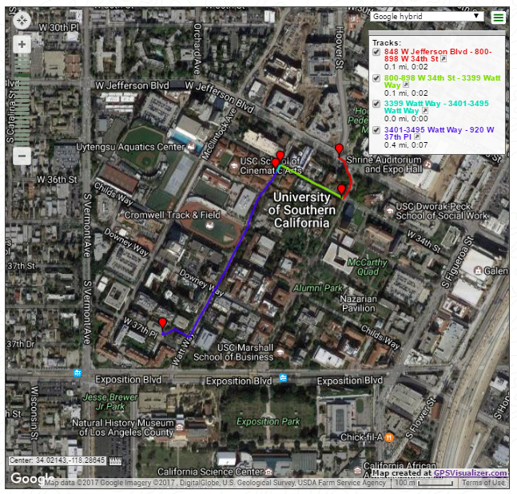
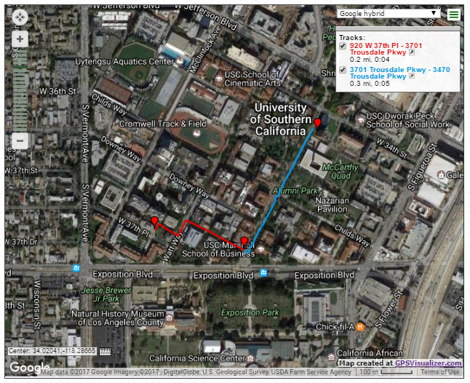
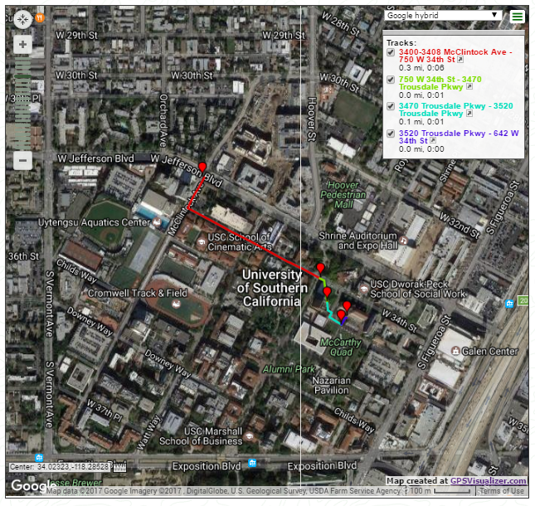
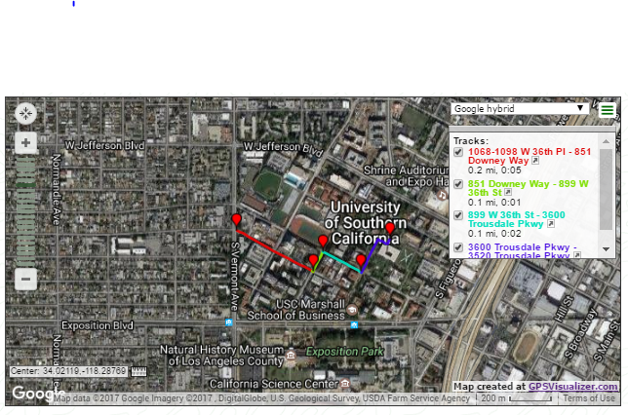
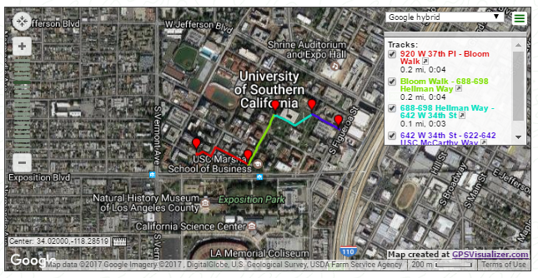

Slide 7
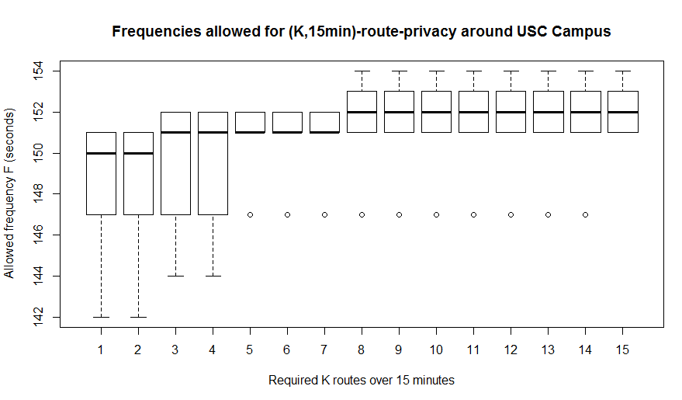
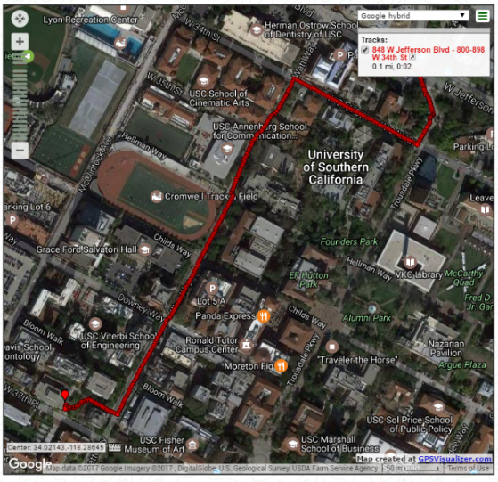
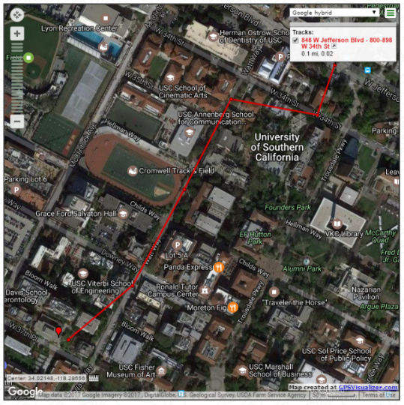
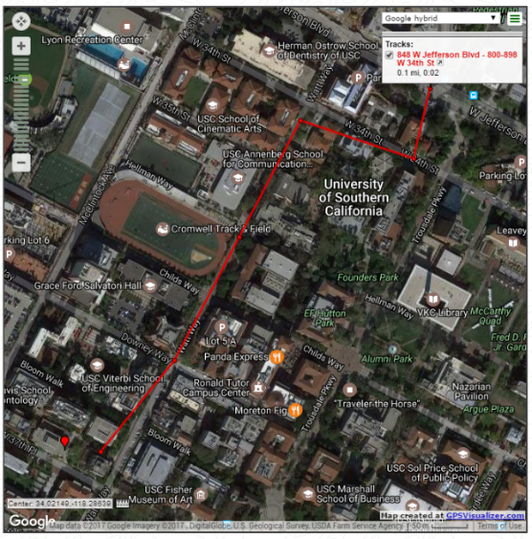
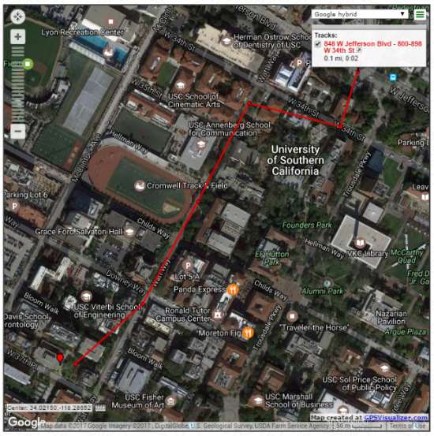
Results on the 5 sample routes
An empirical finding:
An appropriate frequency of sampling pedestrian’s location
Information on USC campus is 150.5733s (one/2.5minutes).

Slide 8
Limitations
Only modeled for pedestrian data.
Implications in route identification algorithm for driving and bicycling.
Route data depends on the GIS systems.
More strict than actual scenarios, even for walking mode. False negatives often occur.
Depends on the maps.
Work as a sampling technique to gather data to set up a privacy policy for a local area.
The “Average” frequency condition in definition doesn’t hold in the simple algorithm.
Involves false negatives.

Slide 9
Applications
Setting up location sampling policy for local areas.
Work as sampling technique to understand averaged frequency should be enforced to ensure K route privacy over time T when developing a policy.
T could be hyper parameter from further study - the average walking time for a local area.
Providing an option for users
understand whether their routes can be inferred.
Providing data for app developers
understand the implications on privacy of the frequency of sampling they set in the app.

Slide 10
Thanks & Questions

